Slide 1
Computational News Project Proposal
Presented by
Chang Li
Ph.D. @ UBTECH Sydney AI Center,
University of Sydney,
CMCRC

Slide 2
Summary
Low Business Value: Data Infrastructure
High Business Value: New Information Generation
Invest in Deep Learning NOT Software Engineering
Proposed Projects:
Specific, Light Area; Fast, Adaptive Iteration
Event Driven Trading
Sentimental Analysis
Notes:
重、周期长、产品不能直接产生商业价值，用户被迫回答问题，产品差异化难
两个问题：数据如何获取？如何利用数据？
专业领域人工智能应用成本远小于大规模数据清洗、标注；软件工程
周期更短、适应需求变化、利润更高
获取数据：体力劳动、软件工程
利用数据：脑力劳动、人工智能

Slide 3
Topics
Computational News Project
Nature of Knowledge Base
Business Value
Our Proposal

Slide 4
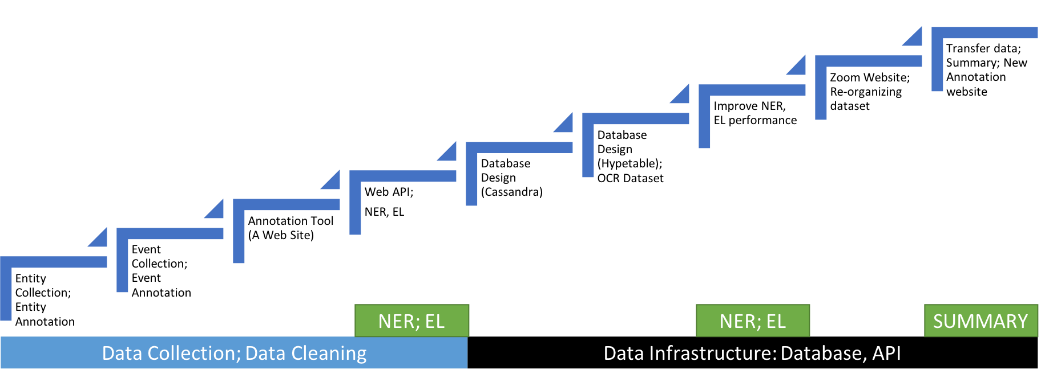
Computational News Project
Waterfall Development Cycle:
Clear (Static) Business Requirements
Long delivery term
~70% Effort Spent on Data Infrastructure
Hard to be adapted to new data source (Changed Database in late phrase)

Slide 5
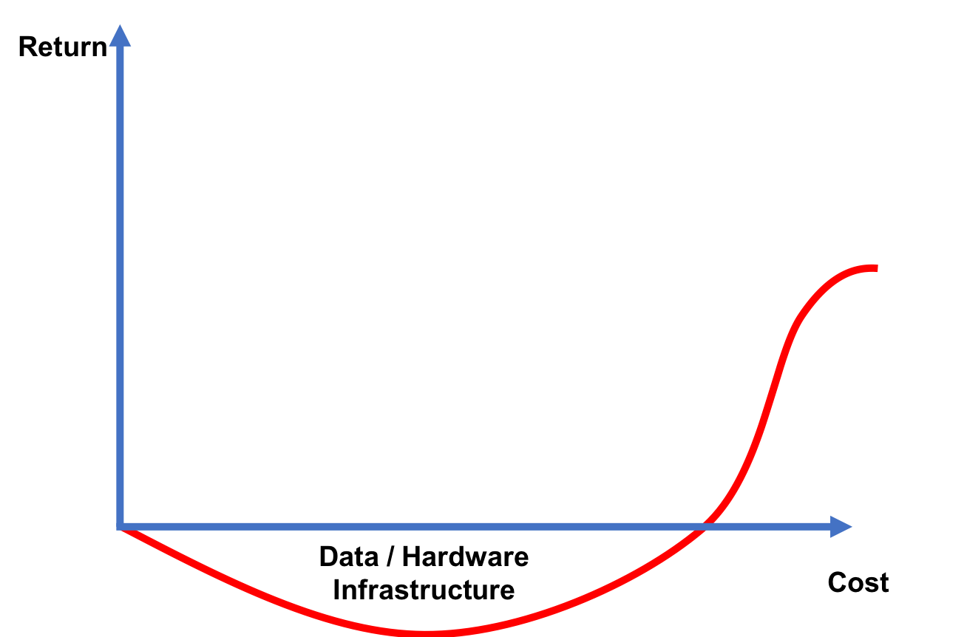
Computational News Project

Slide 6
Computational News Project
Long product delivery term (2~3 years)
High cost
Massive human resources
$150000 = 1 Big Data Engineer
Annotation
Massive hardware cost
Large selling team
Unclear business model
Customer requirements are elusive yet
Hard to be adaptive to changes
Low business value
Expensive selling cost
Low product return

Slide 7
Topics
Computational News Project
Nature of Knowledge Base
Business Value
Our Proposal

Slide 8
Nature of Knowledge Base
Relationships
between
Entities
Supergraph
Frequencies
Sentiment
Logical Inference
Reasoning

Slide 9
Nature of Knowledge Base
The Future of Every Industry
$26B Question: How to Deliver Business Value?
Where is the Data?
How to use it?

Slide 10








Business Value of Knowledge Base
35+ Companies

Slide 11
Business Value of Knowledge Base
New Information
High Business Value
Domain Invariance
Extending Human Capabilities
Application Layer
Knowledge Layer
Efficiency
Low Business Value
Low Motivation
Sensitive to Domains
Customer Education
Data Representation Layer
Structured Data Layer

Slide 12
Business Value: Efficiency
Difficulties
Very Large Scale
Unstructured Dataset
Solutions
High Performance Computing
Hardware / Software Infrastructure
Highly Optimized Engineering
Human Annotation

Slide 13
Business Value: Efficiency
Quandl
Large Scale Datafeed
Consumer transactions, cargo movement, employment trends
BV: Unstructured Data -> Structured
AlphaSense
Linguistic Search Engine
Synonyms; Summary
Over 10k data sources (financial reports & business terms)
Strong sales team
BV: Efficiency
MEMECT (China)
Financial Knowledge Base
Corp Info; Report Generation
BV: Efficiency

Slide 14
Business Value: Efficiency
Summary
Labor / Capital Intensive Industry
Accessory Product: Doesn’t Deliver Business Value Directly
Customer Education
Customer Has to Answer the Question:
How to use the data? What is the business value?

Slide 15
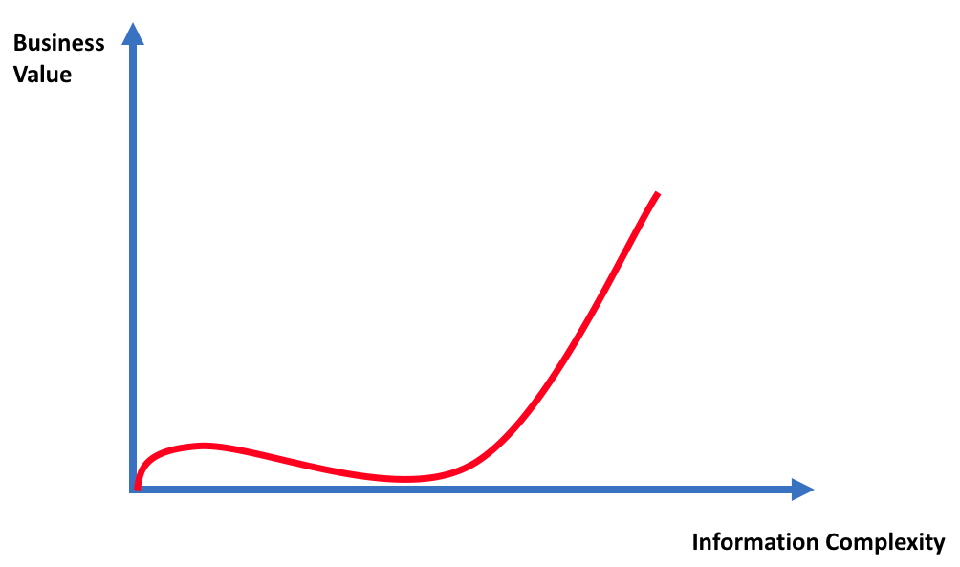
Business Value: New Information

Slide 16
Business Value: New Information
Impossibilities:
Extending Human Capabilities
Very Large Scale
Very Short Time Interval
Very Complex Relationships
Difficulties:
Knowledge Representation
Logical Inference
Reasoning
Solution:
Deep Learning

Slide 17
Business Value: New Information
Dataminr
High impact events from twitter etc.
PR; Corp Alerts; Fin Info
230+ Engineers
BV: Info before in news
Yu Qing Tong (Weibo)
iSentium
Sentiment Indicator from twitter, stocktwits etc.
Indicator for hedge funds
BV: Complex Relationships
Kensho
Financial Knowledge Base
Hidden linkages and systematic behaviors
Acquisited by S&P @ 550M
600 Engineers @ $120K / year
BV: Undiscovered events – asset price relationship
PS: Structured Dataset
PS: Quandl is a datafeed

Slide 18
Topics
Computational News Project
Nature of Knowledge Base
Business Value
Our Proposal

Slide 19
Our Proposal
Facts
Unclear Business Model / Target Market
Expensive Software Engineer Cost $150k/year
Hardware Cost $20m v.s. $2m
Extremely Cheap A.I. Ph.D. Cost $50k/year v.s. $400k/year
Business Value Positive Correlated to Product Complexity

Slide 20
Our Proposal
Objectives
Minimal Data Infrastructure
Minimal Training Data (Annotated Data)
Minimal Data Sources (Structured Data Source)
Minimal Software Engineering
Maximal Business Value
Maximal Relationship Complexity
Impossibilities
Very Large Scale
Very Short Time Interval
Very Complex Relationships
Projects
Event Driven Trading
Sentimental Analysis

Slide 21
Our Proposal: Agile Development Cycle

Slide 22
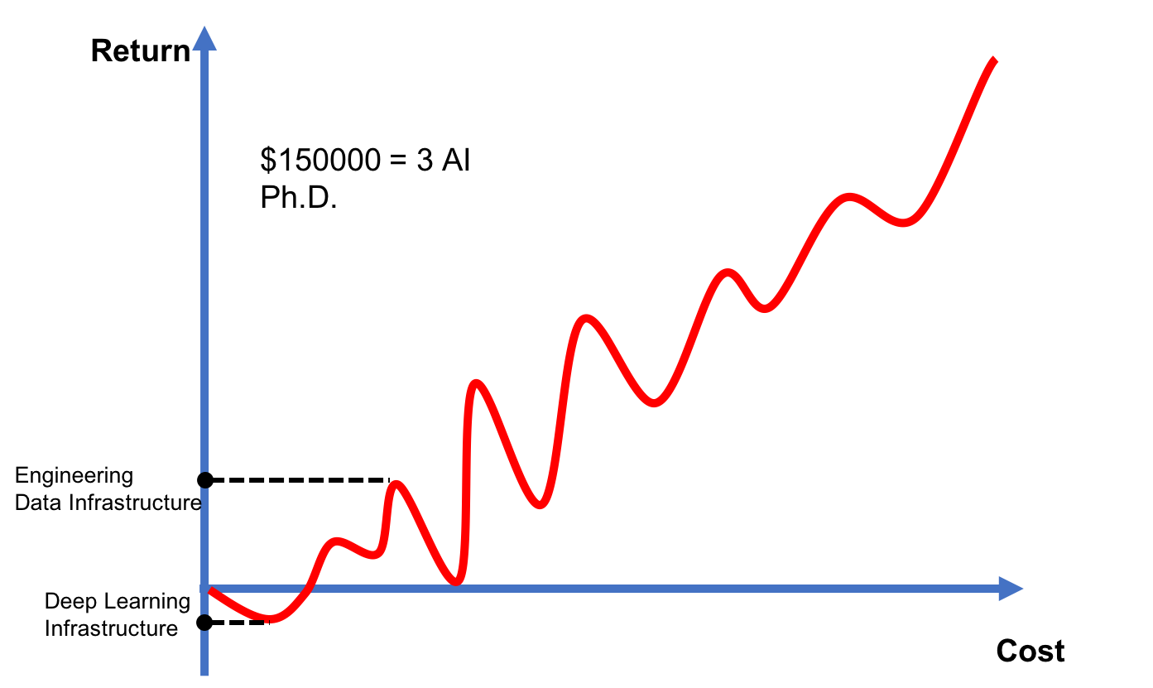
Our Proposal: Agile Development Cycle

Slide 23
Our Proposal: Sentimental Analysis
Pros:
Proven Business Model
Potential MQD Product
Clear Customer Requirements
Structured / Single Data Source
Self-Annotated Data; Semi / Unsupervised Learning
Cons:
Competitors
Hard to differentiate

Slide 24
Our Proposal: Event Driven Trading
Pros:
ALTA 2015 1st Place (En – Fr Cognates)
ICDM Business Chain Prediction Paper
4~6 Months Proof of Concepts = MVP
Structured / Single Data Source
Self-Annotated Data; Semi / Unsupervised Learning
Results Transferable to Other NLP Tasks
Cons:
4~6 Months Proof of Concepts

Slide 25
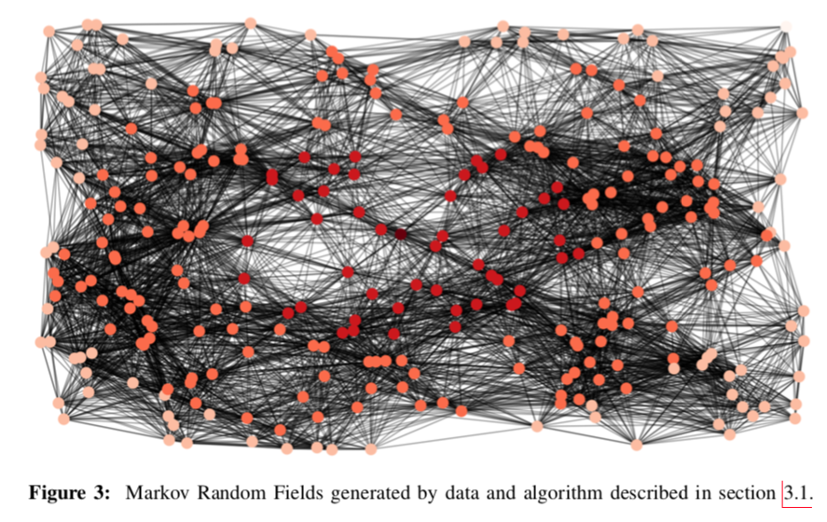
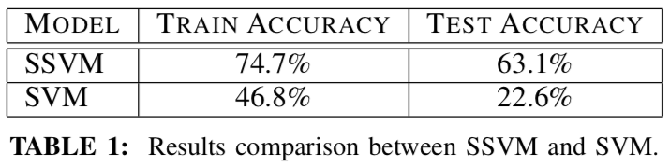
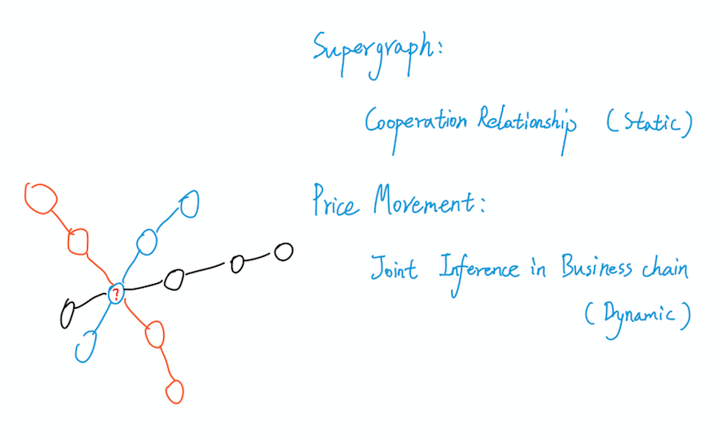
Appendix: ICDM 2017 Paper

